Slide 1
DATA ANALYSIS / PORTFOLIO PROJECT
E-COMMERCE
SALES & CUSTOMER
ANALYSIS
₹17.71 Cr
Net Sales
₹7.61 Cr
Total Profit
From raw transactions to business decisions
138,116
Transactions / rows
01

Slide 2
01 / EXECUTIVE VIEW
The business is profitable — but margin leakage needs attention
Key statistics calculated directly from the notebook outputs.
43.0%
₹1,282
775,555
0.94%
Overall profit / net sales
Average net sales per row
Total quantity sold
Rows with negative profit
• South is the largest revenue region at ₹5.56 Cr (31.4% of total net sales).
• Consumer is the dominant customer segment at ₹9.72 Cr (54.9% of total net sales).
• The top 10 customers contribute ₹2.80 lakh in net sales and ₹1.18 lakh in profit.
• 1,296 rows are loss-making; the sample shows product cost exceeding net sales in several cases.
02

Slide 3
02 / QUESTIONS ANSWERED
What did the analysis actually investigate?
• How large is the dataset?
• How many columns and rows are present?
• Where are missing values?
• Are duplicate records present?
• What are total revenue, profit and quantity sold?
• What is the average net sales value?
• Which customers generate the most revenue?
• How do regions compare on sales, profit and order volume?
• What are the strongest monthly sales periods?
• How do customer segments compare on sales and profit?
• How many loss-making rows exist?
• How does discount percentage relate to individual profit examples?
03

Slide 4
03 / DATA QUALITY
The dataset is large enough for meaningful segmentation
138,116 rows × 46 original columns; two derived time columns were added later.
138,116
46
0
0
Rows
Original columns
Missing in core financial fields
Duplicate flags shown
• Core commercial measures — net_sales, product_cost, profit and profit_margin_percentage — have no missing values.
• Operational/feedback fields contain missing values: delivery_days, estimated_delivery_days, customer_rating, review fields, campaign_name and coupon_code.
• return_status and return_reason are populated only for a subset of records, which is expected for return-related fields.
• The notebook converts order_date to datetime and derives year and month for time-based analysis.
04

Slide 5
04 / BUSINESS STATISTICS
The headline economics of the dataset
₹17.71 Cr
₹7.61 Cr
₹10.10 Cr
43.0%
Total net sales
Total profit
Sales minus profit
Aggregate margin
What this means
• The dataset generates about ₹17.71 crore in net sales and ₹7.61 crore in profit.
• Aggregate profit margin is 43.0% when total profit is divided by total net sales.
• Average net sales per row is ₹1,282, while total quantity sold is 775,555 units.
• These are portfolio-level KPIs; they should be interpreted alongside product cost, discounting and customer mix.
05

Slide 6
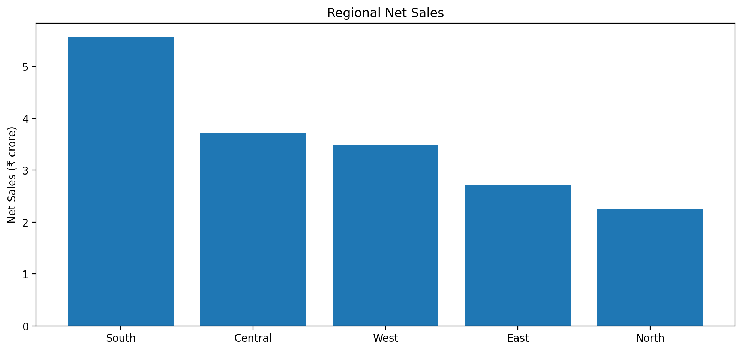
05 / REGIONAL PERFORMANCE
South drives scale; North is smaller but relatively efficient
Regional margin = profit ÷ net sales.
South: ₹5.56 Cr sales | ₹2.33 Cr profit | 42.0% margin
Central: ₹3.72 Cr sales | ₹1.56 Cr profit | 41.9% margin
West: ₹3.48 Cr sales | ₹1.56 Cr profit | 45.0% margin
East: ₹2.71 Cr sales | ₹1.12 Cr profit | 41.3% margin
06
North: ₹2.26 Cr sales | ₹1.04 Cr profit | 46.1% margin

Slide 7
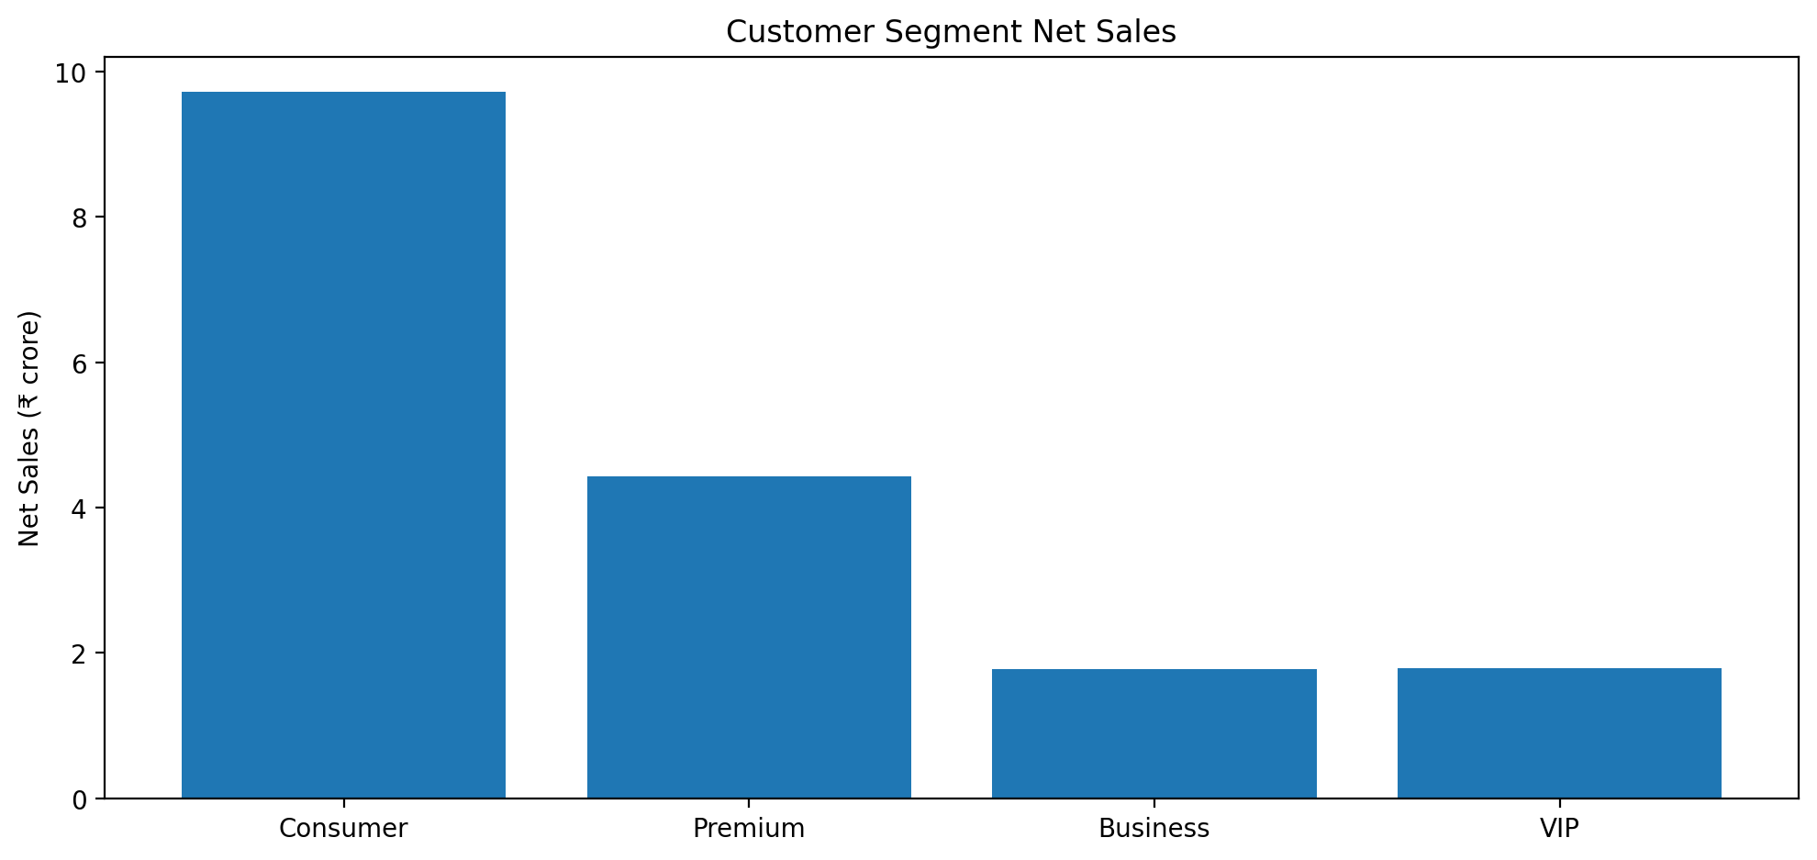
06 / CUSTOMER SEGMENTS
Consumer is the engine of the portfolio
Consumer
₹9.72 Cr sales • ₹4.28 Cr profit • 44.1% margin
Premium
₹4.43 Cr sales • ₹1.82 Cr profit • 41.1% margin
VIP
₹1.79 Cr sales • ₹0.74 Cr profit • 41.1% margin
Business
₹1.78 Cr sales • ₹0.78 Cr profit • 43.8% margin
Consumer alone accounts for 54.9% of total net sales.
07

Slide 8
07 / CUSTOMER VALUE
The top 10 customers are meaningful, high-value accounts
Ranking in the notebook is based on total net sales; the output also includes profit, customer_order_count and CLV.
Customer
Net Sales
Profit
Order Count
CLV
CUST-012869
₹30,268
₹11,819
225
₹454,027
CUST-002969
₹30,062
₹11,704
256
₹480,985
CUST-017251
₹29,375
₹10,563
225
₹440,630
CUST-000802
₹28,503
₹12,782
156
₹349,895
CUST-012608
₹28,172
₹13,994
169
₹366,238
CUST-017828
₹28,093
₹12,398
196
₹393,302
CUST-006857
₹26,835
₹9,357
110
₹274,309
CUST-017523
₹26,777
₹12,663
81
₹240,990
Top 10 sales = ₹2.8 lakh (0.16% of total sales)
Top 10 profit = ₹1.2 lakh (0.15% of total profit)
08

Slide 9
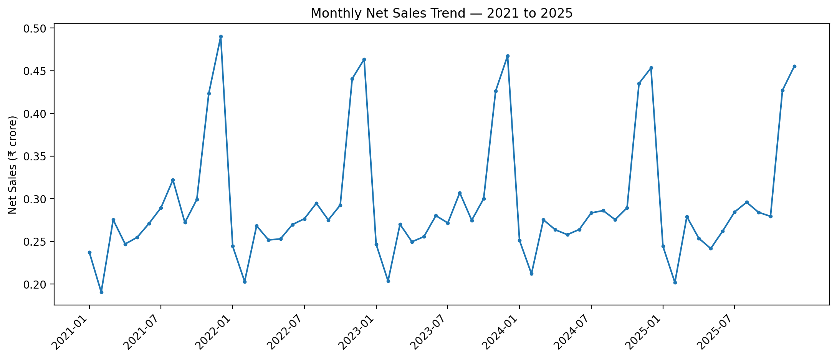
08 / TIME & SEASONALITY
Year-end demand is consistently stronger
Monthly net sales from 2021–2025.
Best month: 2021-12 at ₹49.01 lakh | Best full year: 2021 at ₹3.57 Cr
09

Slide 10
09 / PROFIT LEAKAGE
1,296 rows are loss-making
The notebook defines loss-making rows as profit < 0.
1,296
0.94%
46.30%
Negative-profit rows
Share of all rows
Discount on one sample loss row
• Sample loss-making records show product_cost greater than net_sales in multiple cases.
• Examples include ORD-773460: net sales ₹2,018.41 vs product cost ₹2,031.88 → profit −₹22.47.
• ORD-828591 shows net sales ₹2,298.28 vs product cost ₹2,533.00 → profit −₹240.49.
• ORD-613985 shows net sales ₹2,011.70 vs product cost ₹2,202.05 → profit −₹201.44.
• The notebook calculates discount_percentage = discount_amount / gross_sales × 100, but it does not yet quantify the overall discount–profit correlation.
10

Slide 11
10 / DISCOUNT ANALYSIS
High discounting can coexist with negative profit — but correlation is not yet proven
The notebook calculates discount percentage and inspects examples.
Example
46.3%
−₹22.47
36.5%
₹345.04
Discount % — ORD-773460
Profit — same row
Discount % — ORD-301242
Profit — same row
• The two examples demonstrate why discounting should be evaluated together with product cost and selling price.
• A high discount does not automatically imply a loss, and a lower discount does not guarantee high profit.
• Next analytical step: group discount_percentage into bands and compare average profit/margin, then calculate correlation.
11

Slide 12
11 / BUSINESS IMPROVEMENT
Three actions that follow from the evidence
01
CONTROL MARGIN LEAKAGE
Introduce a minimum margin guardrail for discounted transactions; flag orders where net_sales approaches or falls below product_cost.
02
ACTIVATE PEAK DEMAND
Use the recurring Nov–Dec sales uplift to pre-plan inventory, campaigns and fulfillment capacity.
03
PROTECT HIGH-VALUE CUSTOMERS
Build retention and cross-sell programs around customers with high sales, profit and CLV.
12

Slide 13
FINAL TAKEAWAY
A profitable e-commerce portfolio
with clear opportunities to improve
margin discipline and customer value.
₹17.71 Cr sales • ₹7.61 Cr profit • 43.0% aggregate margin • 1,296 loss-making rows
Pandas + NumPy | Evidence → Insight → Recommendation
Krish Bhatia
Krishbhatia624@gmail.com
+91-7657909464
14

